Slide 1

Image processing & facial recognition
Ben Anderson

Slide 2
The project
The aim of this project is to develop an Android application which will provide a user with the ability to carry out image processing on an image of their choice, as well as the ability to carry out facial recognition.
Various experiments have been carried out to investigate the positive or negative results image processing may have on the accuracy of recognition.
The variety of image processing functionality available for use in the application have been investigated and developed without the use of external packages such as OpenCV.
The facial recognition feature makes use of patch based correlation calculations, to calculate scores and determine features which may be used to identify a person.
The application makes use of a database of known personnel known as the LFW crop dataset, a database of face photographs designed for studying the problem of unconstrained face recognition.

Slide 3
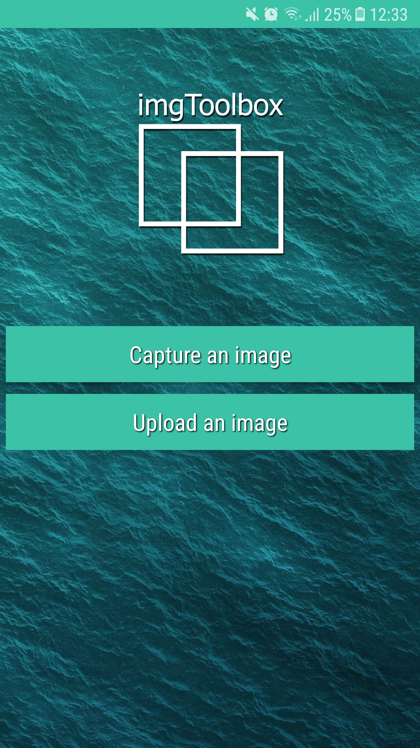
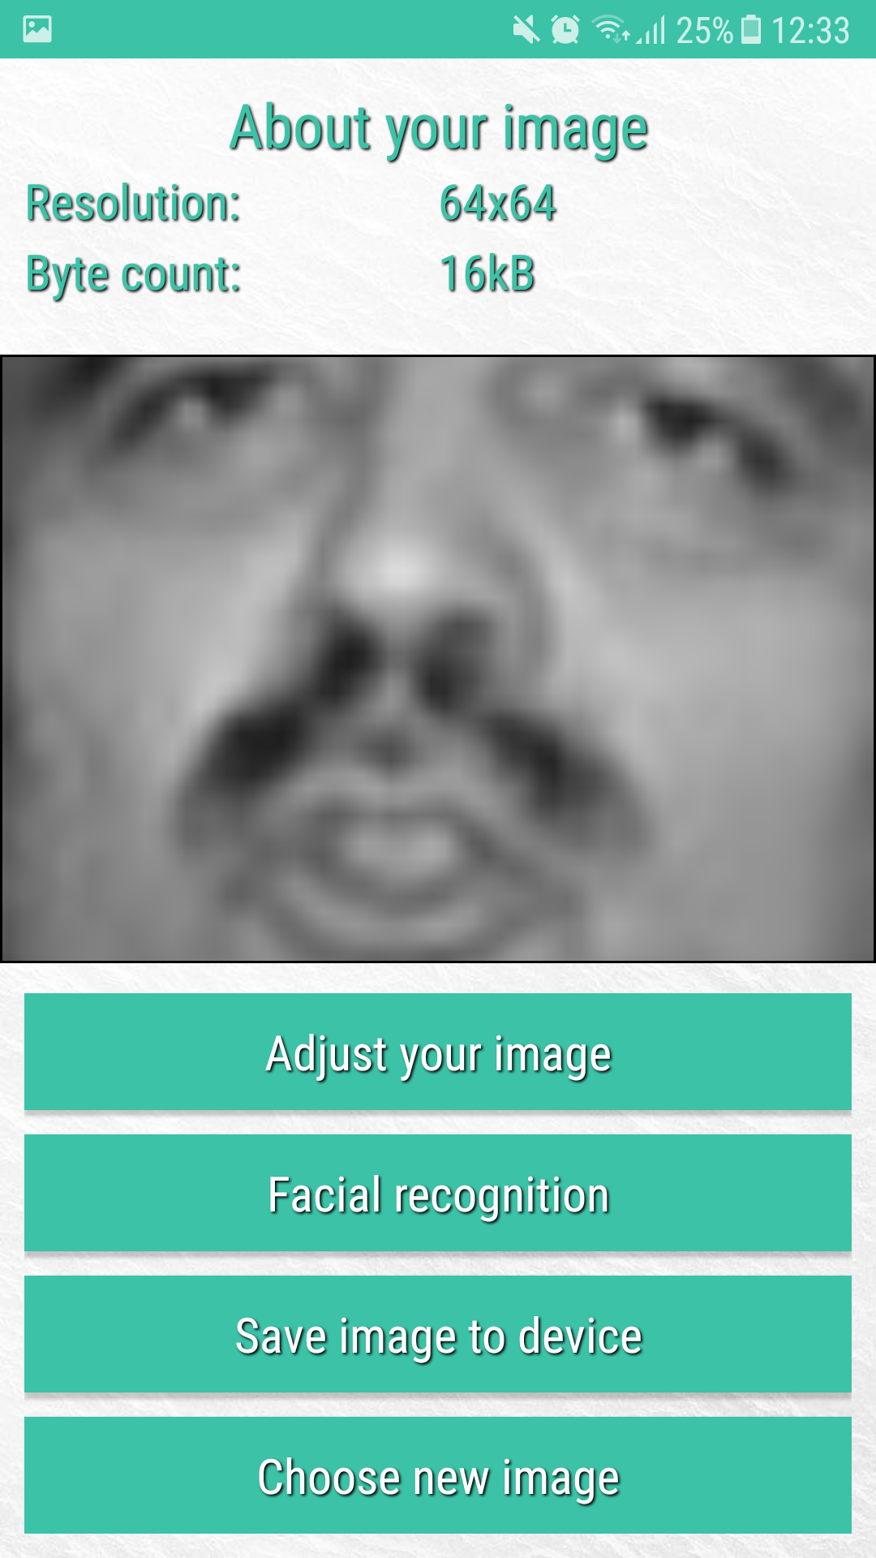
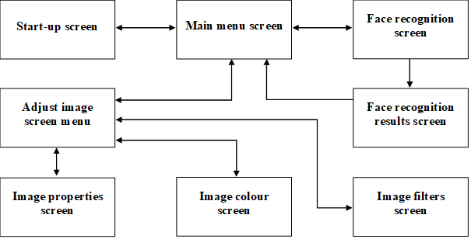
The application
An android application developed in Java compatible with devices running Android KitKat, Lollipop, Marshmallow and Nougat (Android OS 4.4 to 7.1).
Application made up of various screens which provide image processing or facial recognition capabilities.

Slide 4
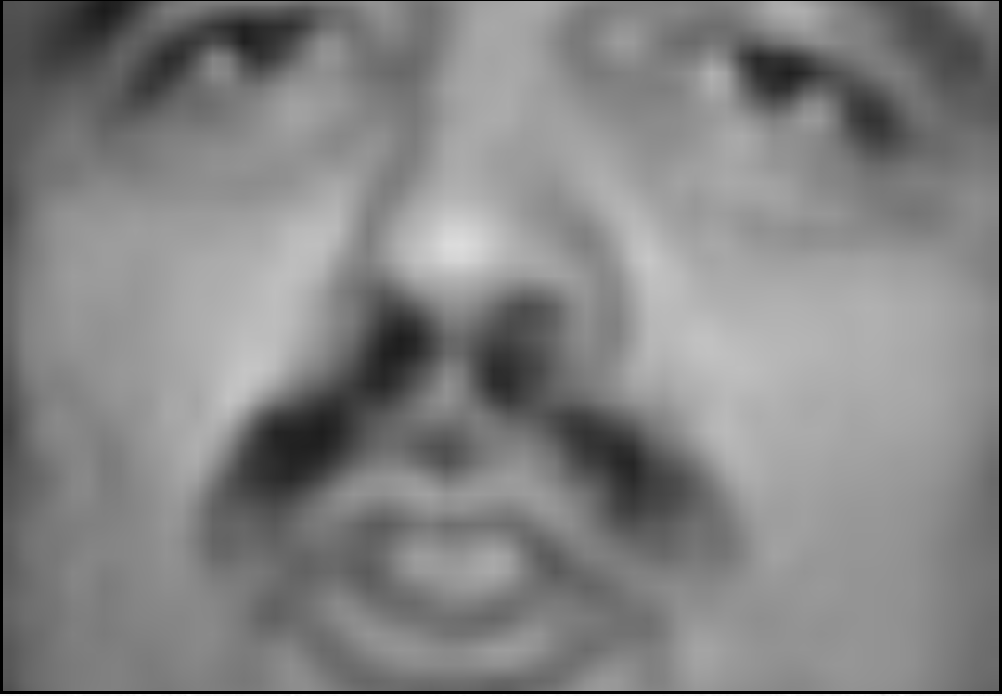
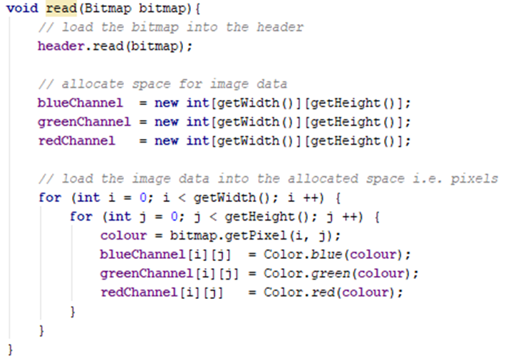
The user’s image
The user can choose to capture an image with the devices camera, or upload an image from the devices photo gallery.
The users image can be made up of hundreds or thousands of pixels. Each pixel contains data for each colour channel contains an RGB value, which represents the luminosity and colour of the pixel. (This is the data used for image processing and facial recognition)
To store the image data, the application uses a bitmap which is controlled by an image object class. (Image.java)
E.g. (Image 64 x 64px)
A pixel at co-ordinates (x, y) may hold this data:
[167, 255, 0]

Slide 5
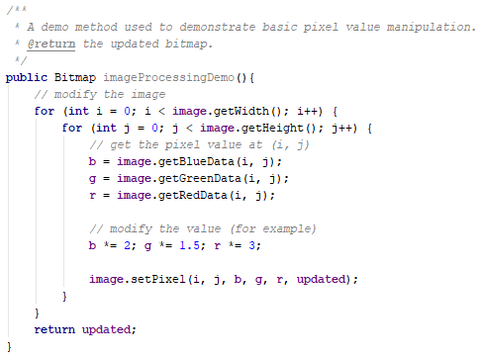
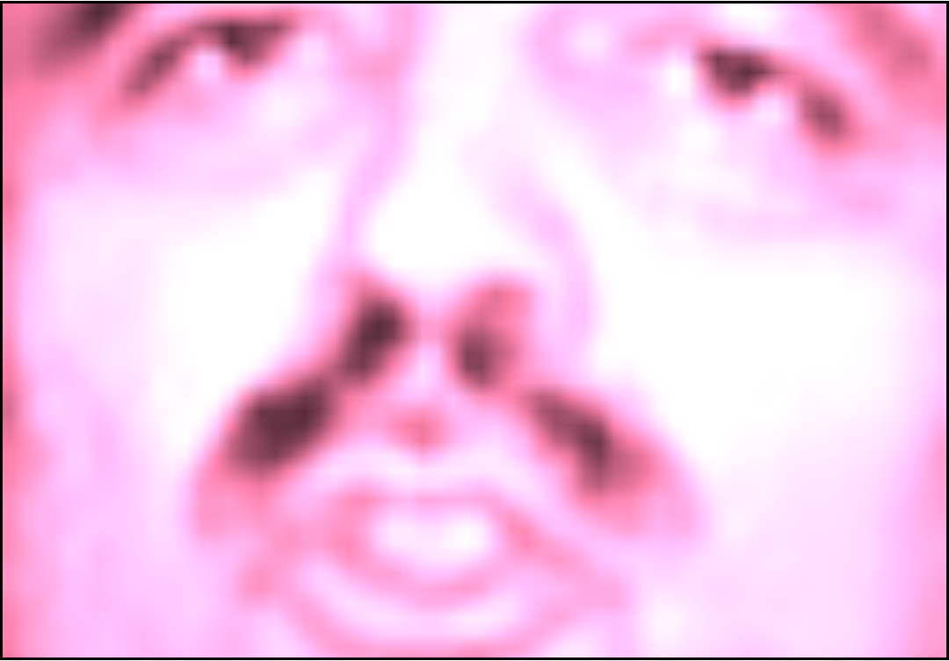
What is image processing?
Image processing is defined as the analysis and manipulation of a digitized image, especially in order to improve its quality or alter the overall appearance.
The example below illustrates how image processing can result in a drastic change to an image.
The algorithm iterates every pixel in the user’s image carrying out the following calculation on the data in each: (blue(x, y) * 2, (green(x, y) * 1.5), (red(x, y) * 3)
Original image Example algorithm Resulting image

Slide 6
Image processing toolkit
The application developed makes use of an image processing toolkit which provides the ability of the user to:
Increase/decrease brightness
Increase/decrease contrast
Increase/decrease saturation
Increase/decrease exposure
Manipulate colour channel ratios
Simulate additional image noise
Add blur to simulate out of focus images
Carry out basic edge detection
The algorithms provided by the toolkit have been developed in house without the help of external packages such as OpenCV.

Slide 7
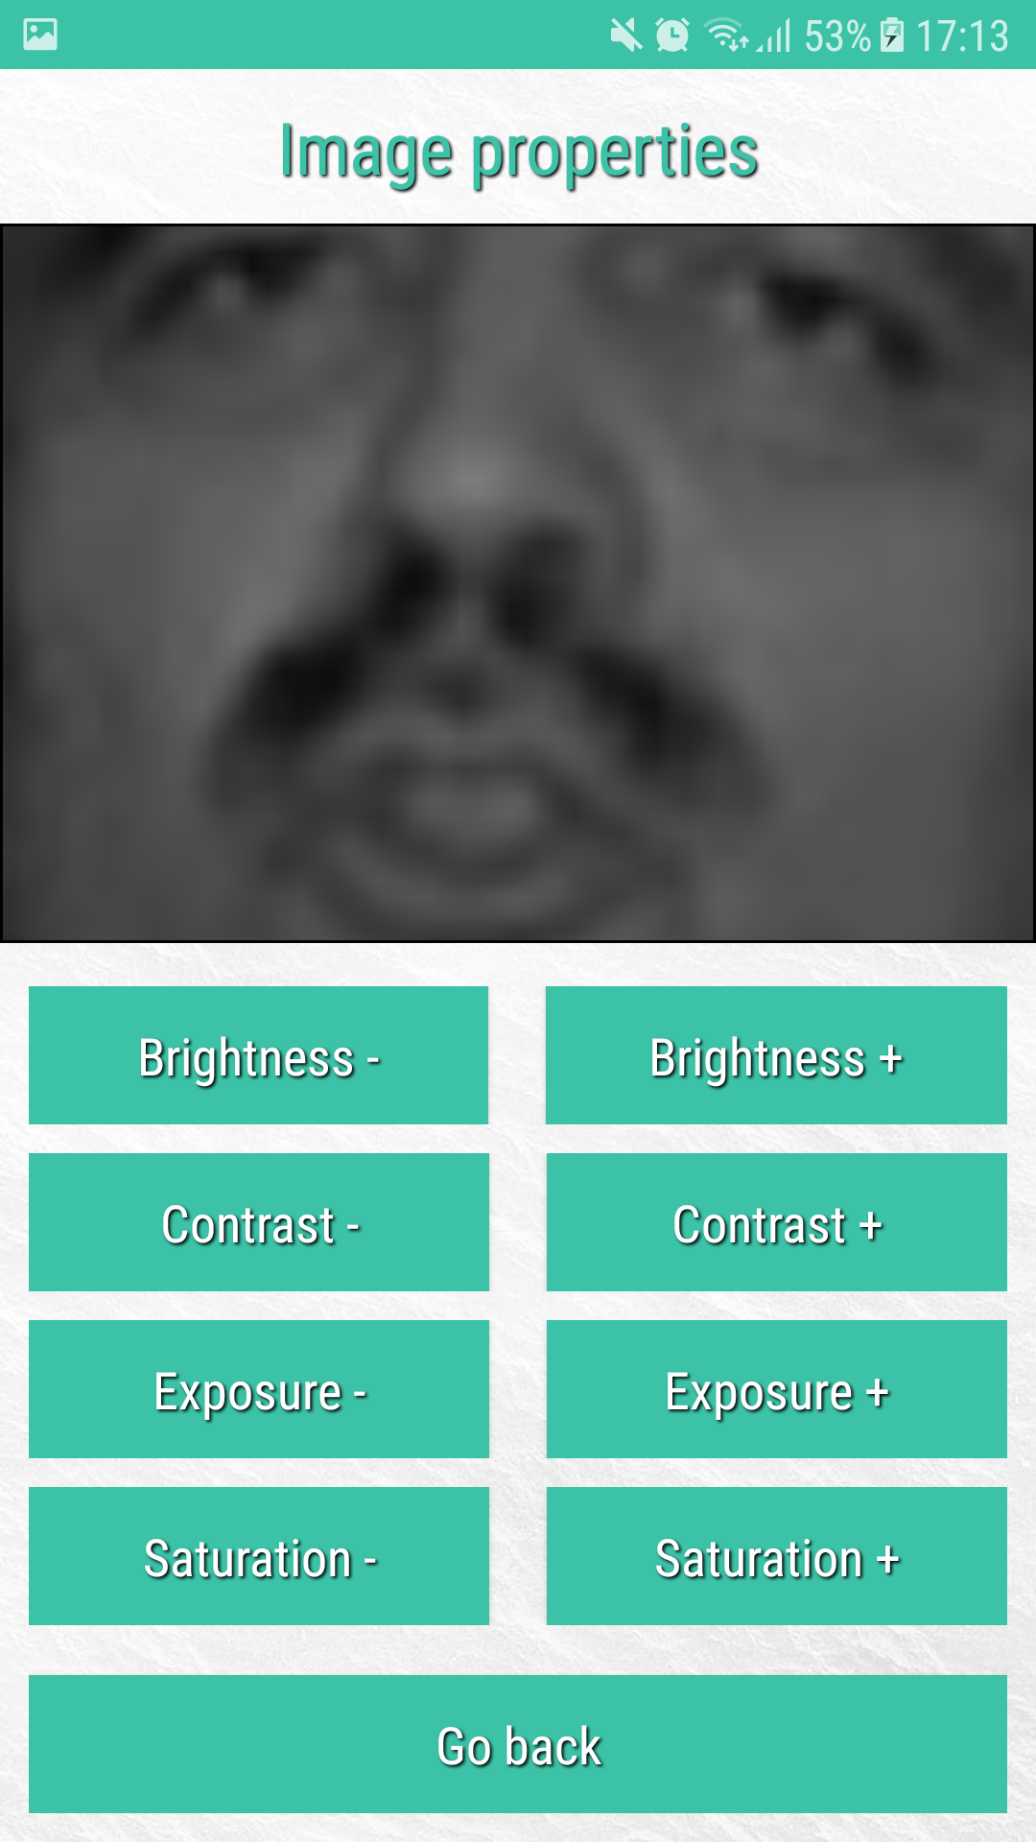
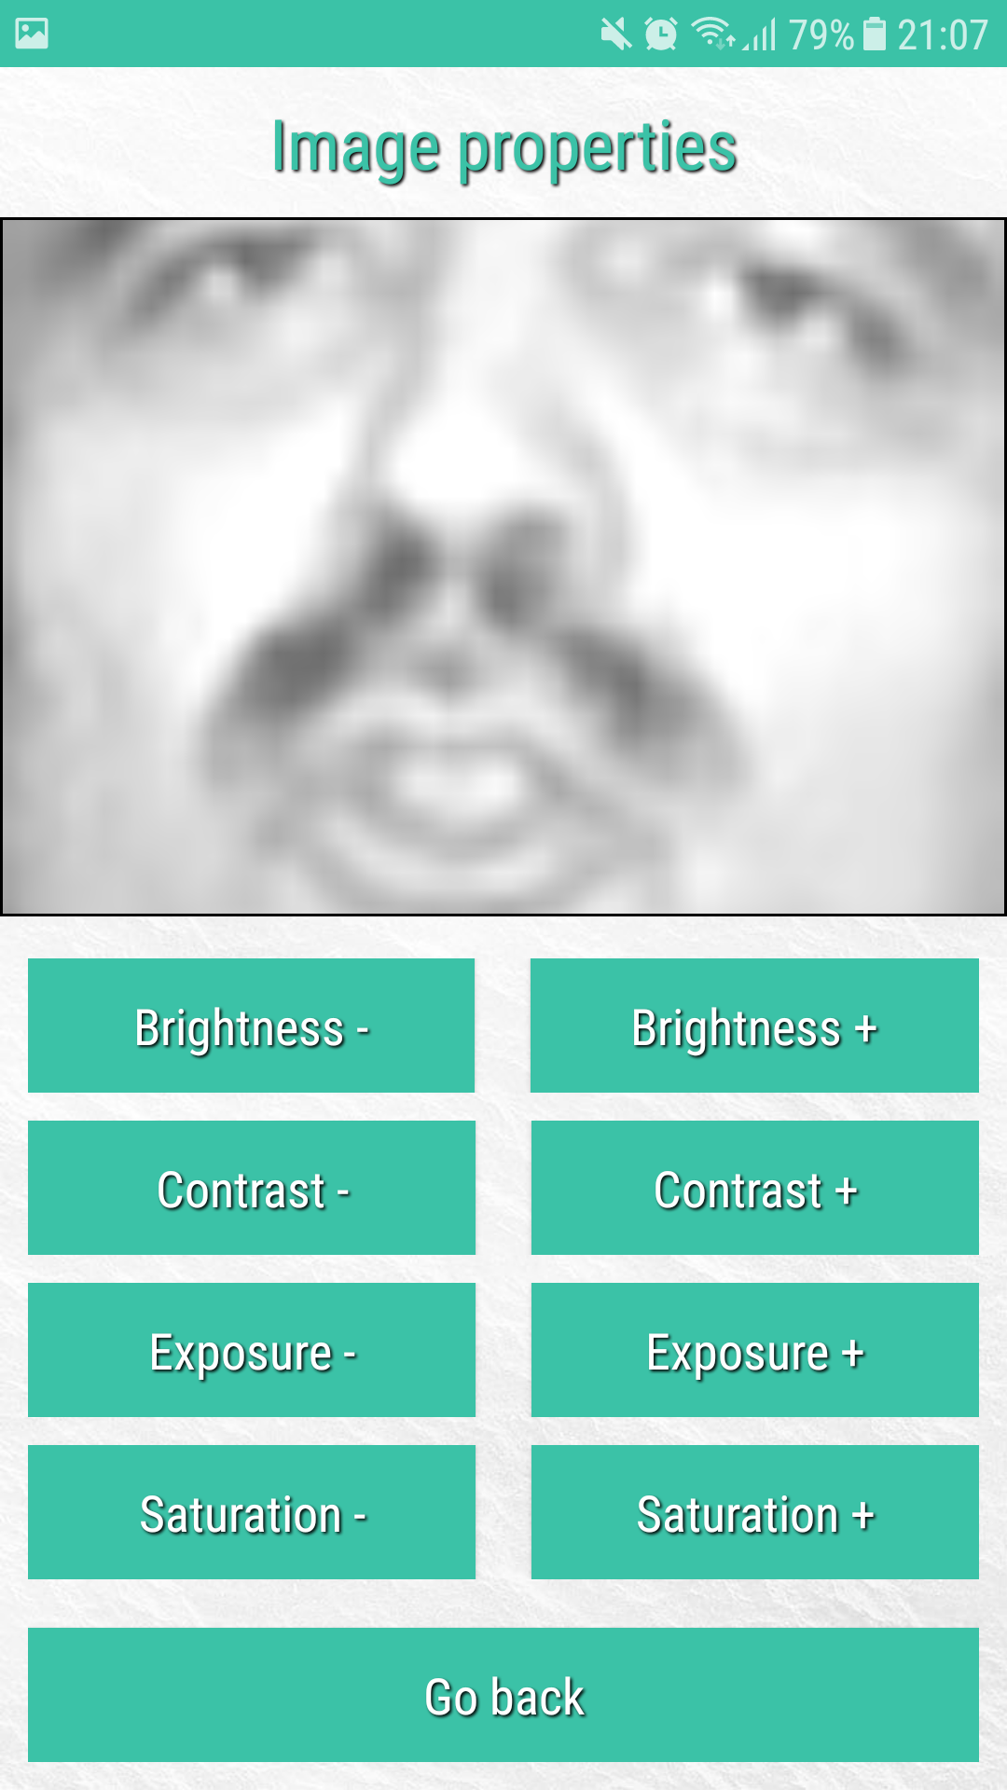
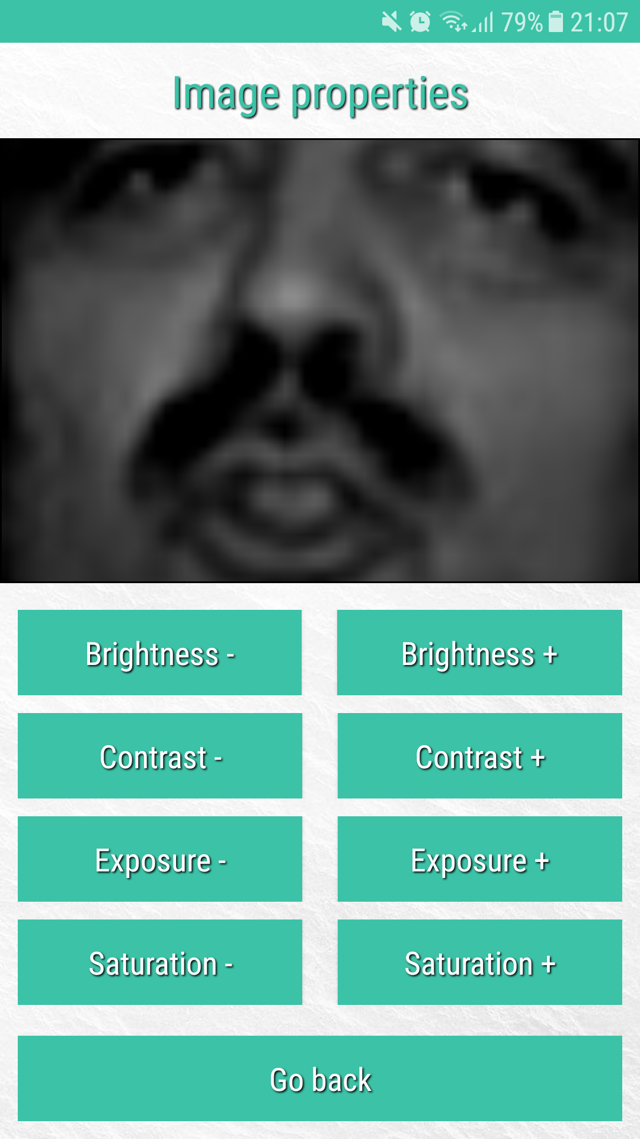
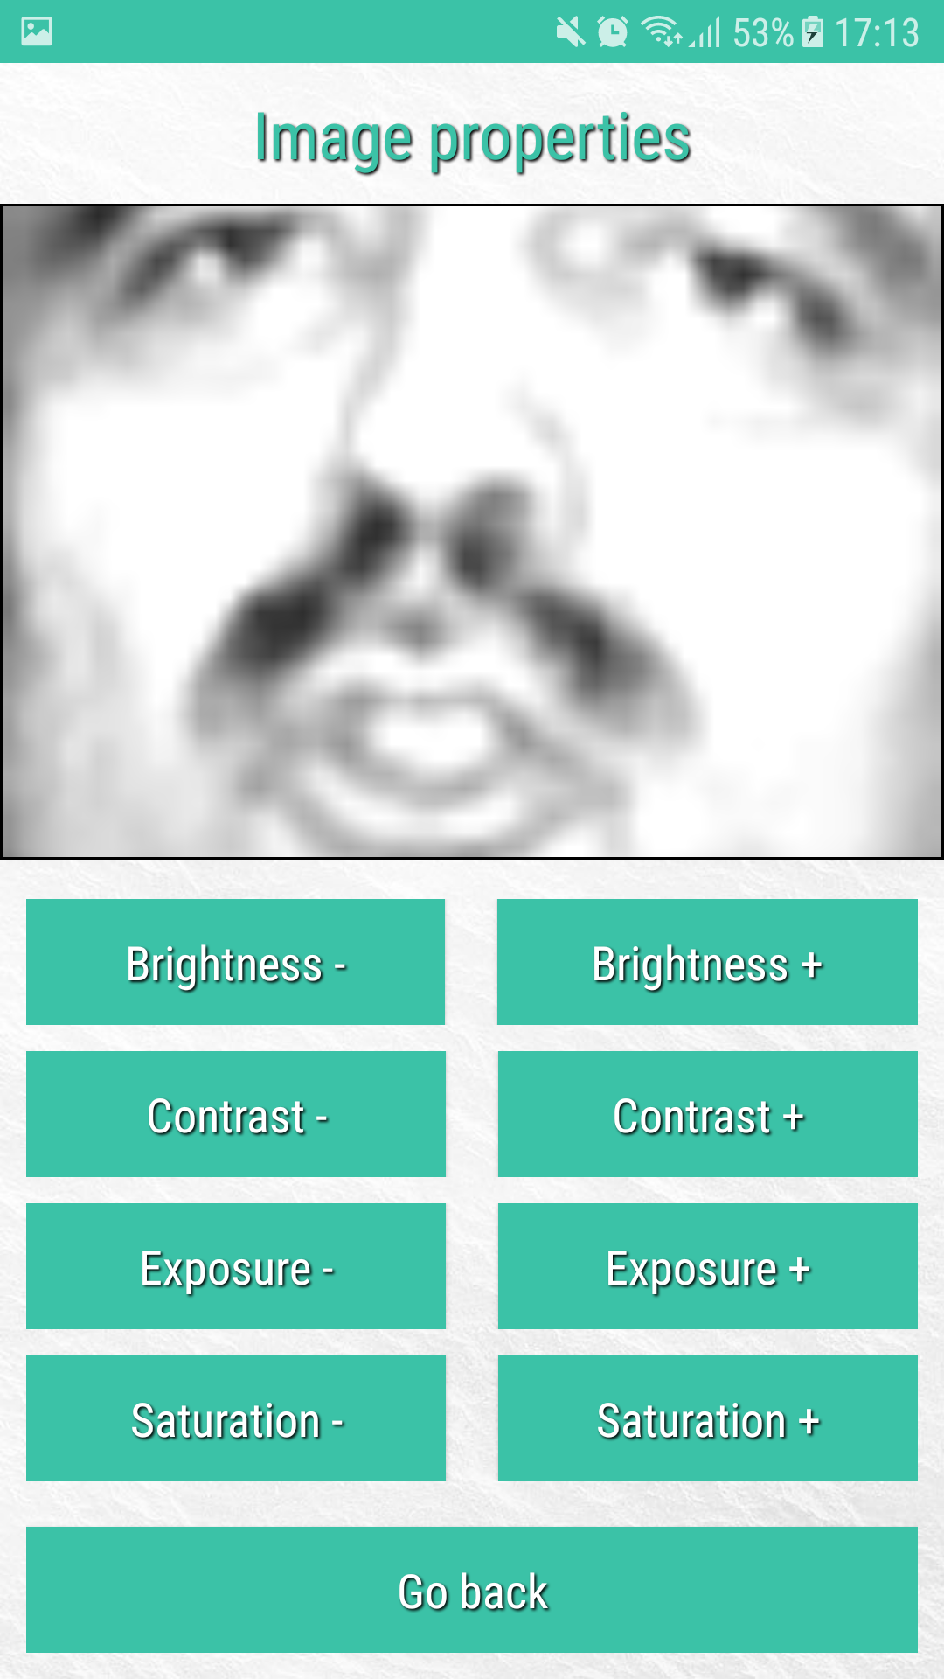
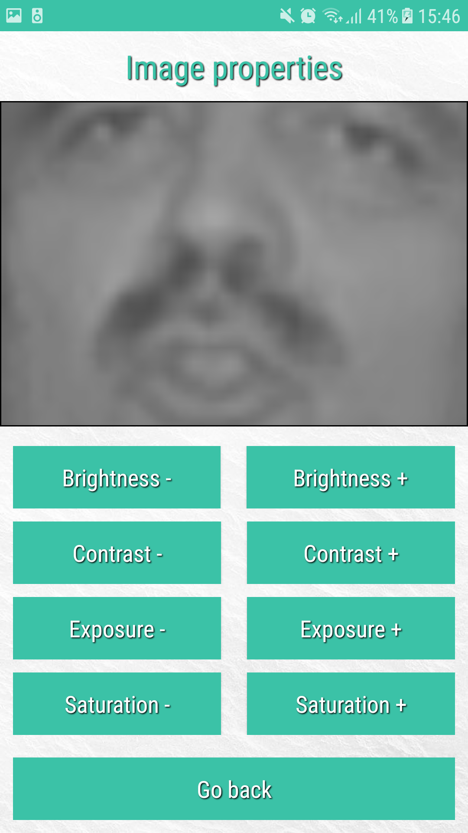
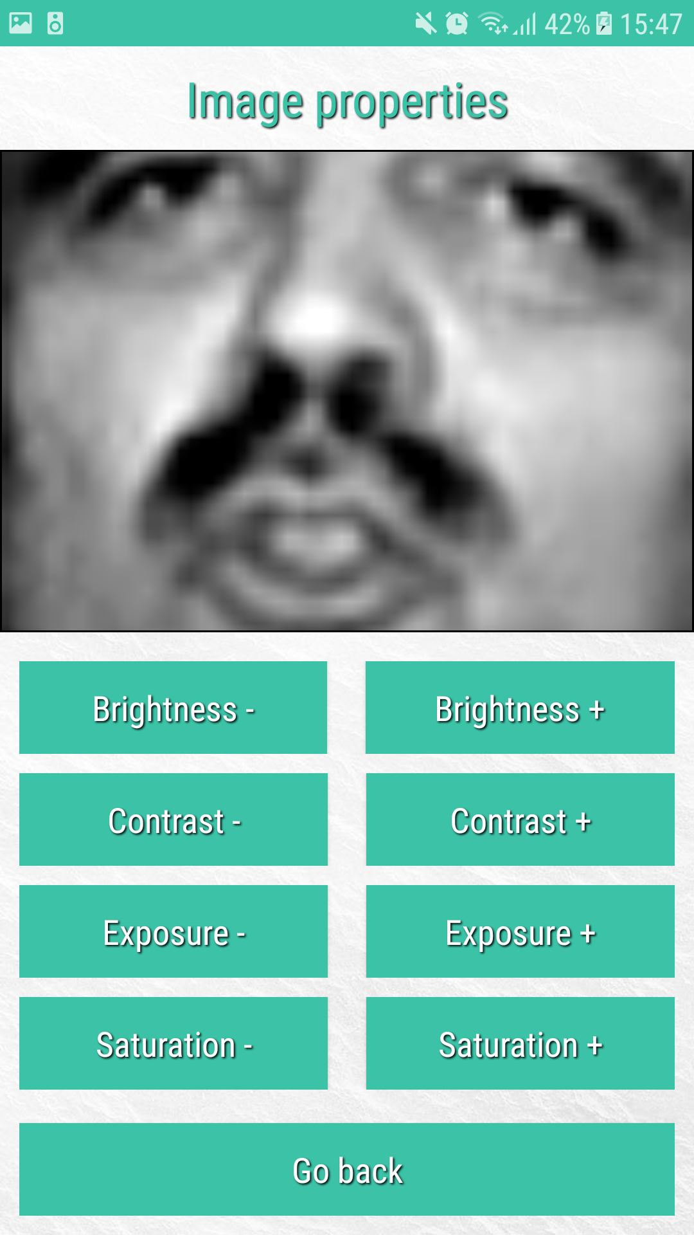
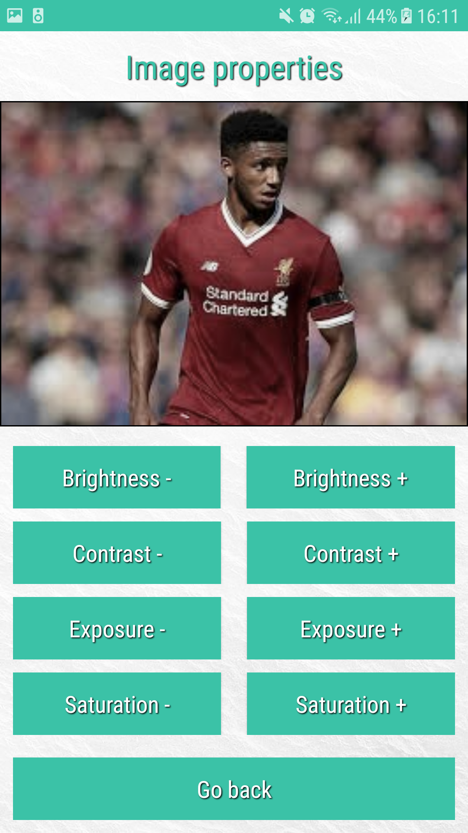
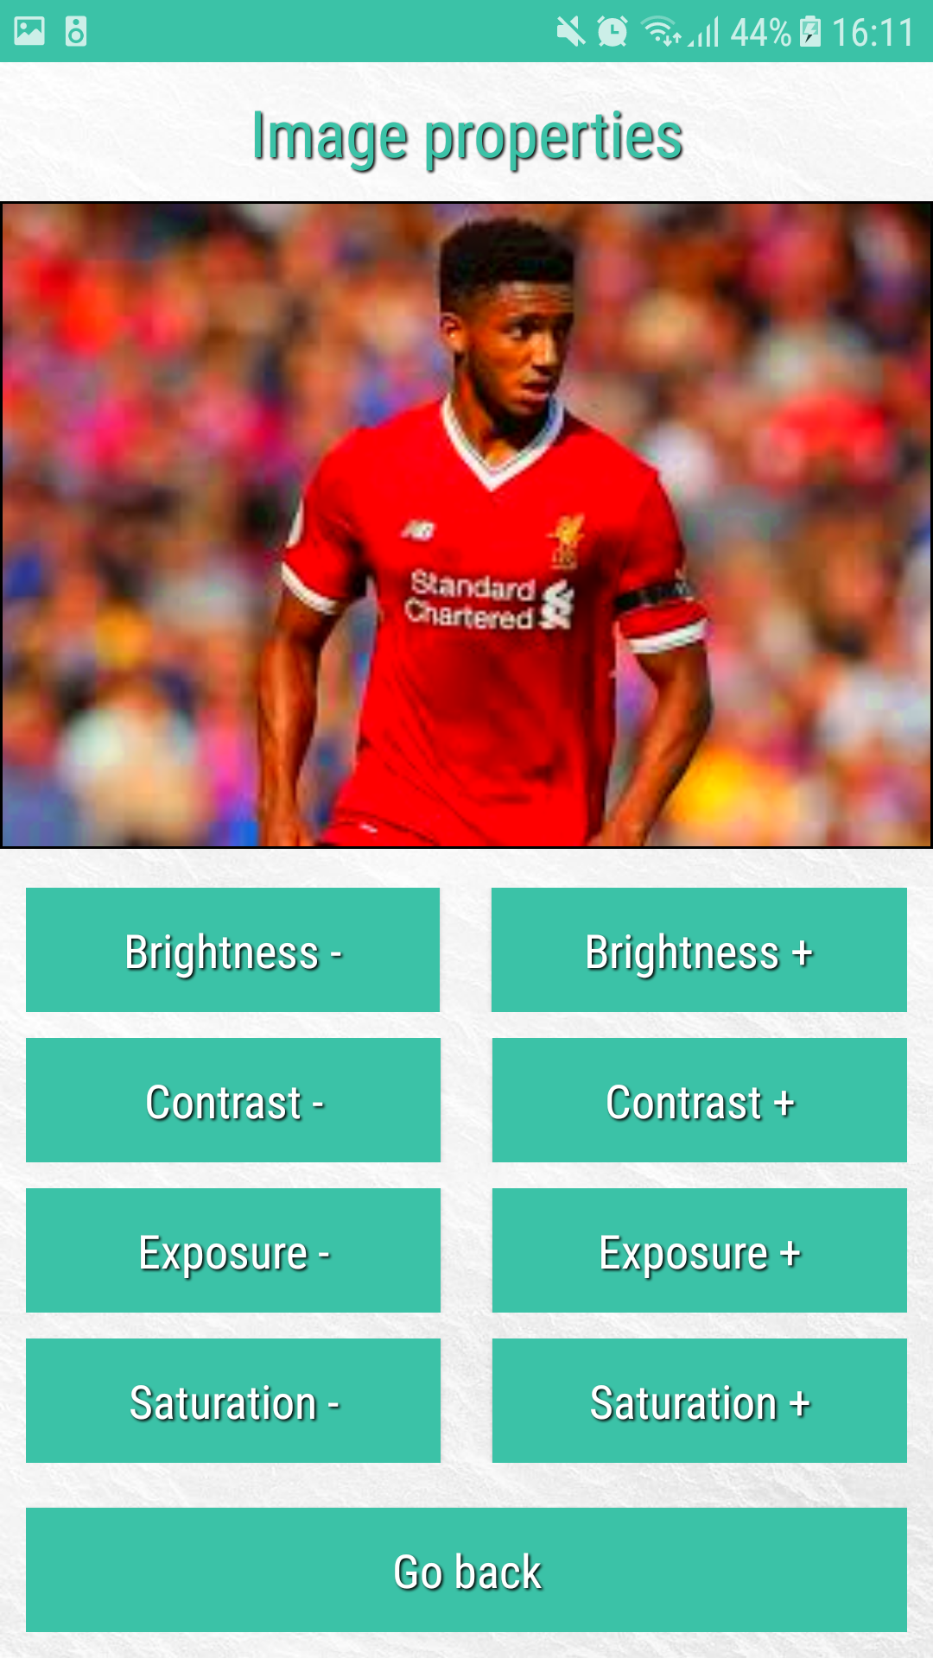
Toolkit features
The effects of the various types of image processing algorithms developed are illustrated below:
1. Brightness 2. Contrast 3. Exposure 4. Saturation
Decrease brightness
Increased brightness
Decrease exposure
Increased exposure
Decrease contrast
Increased contrast
Decreased saturation
Increased saturation

Slide 8
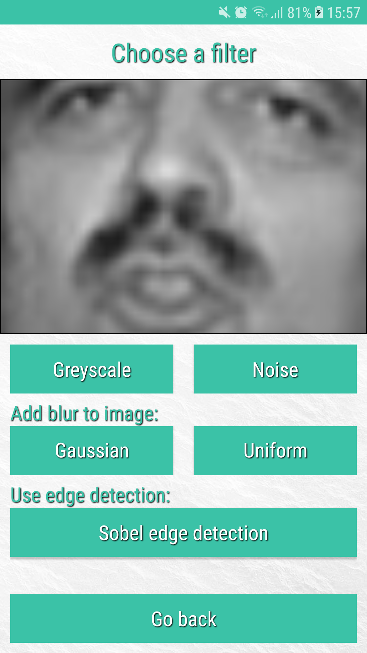


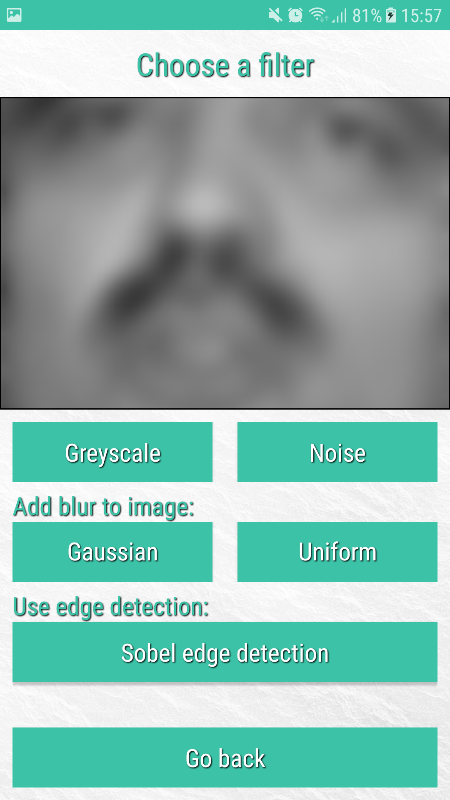
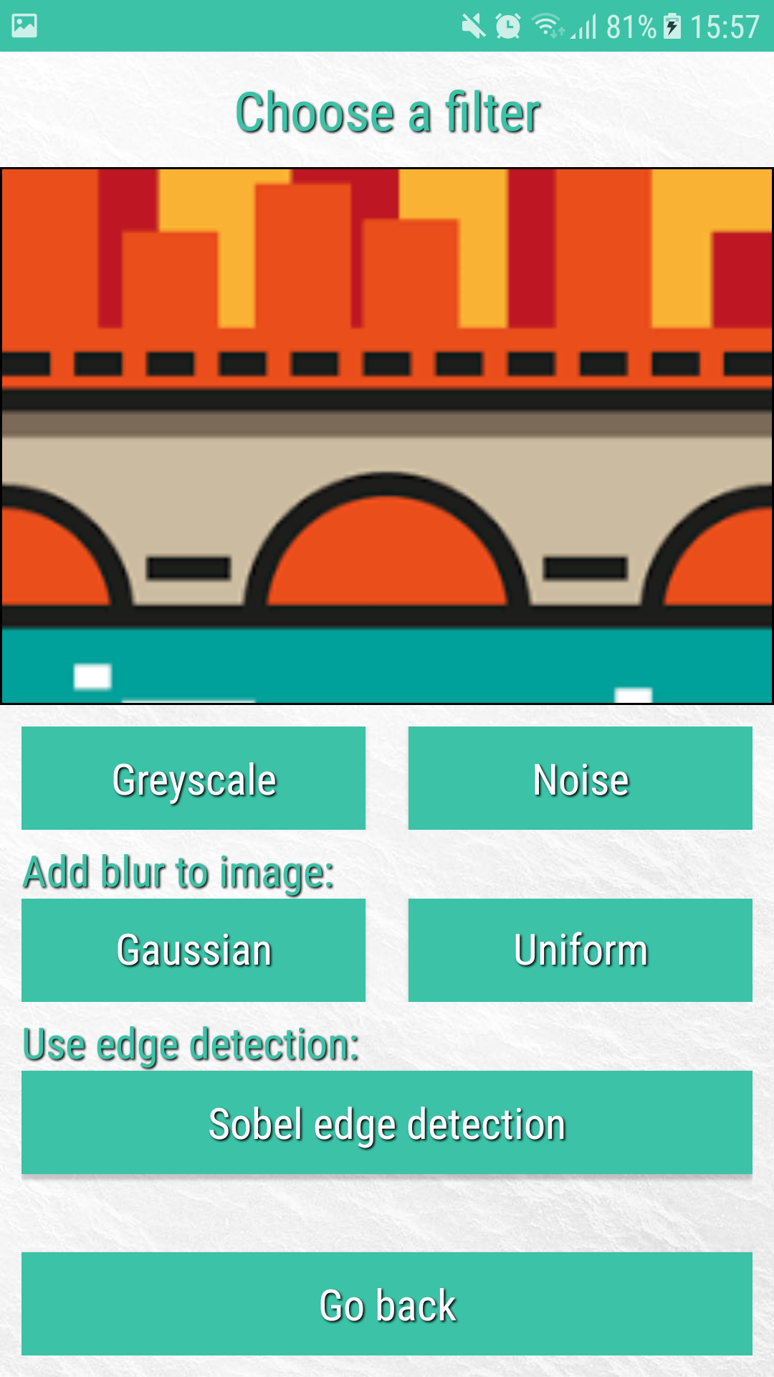
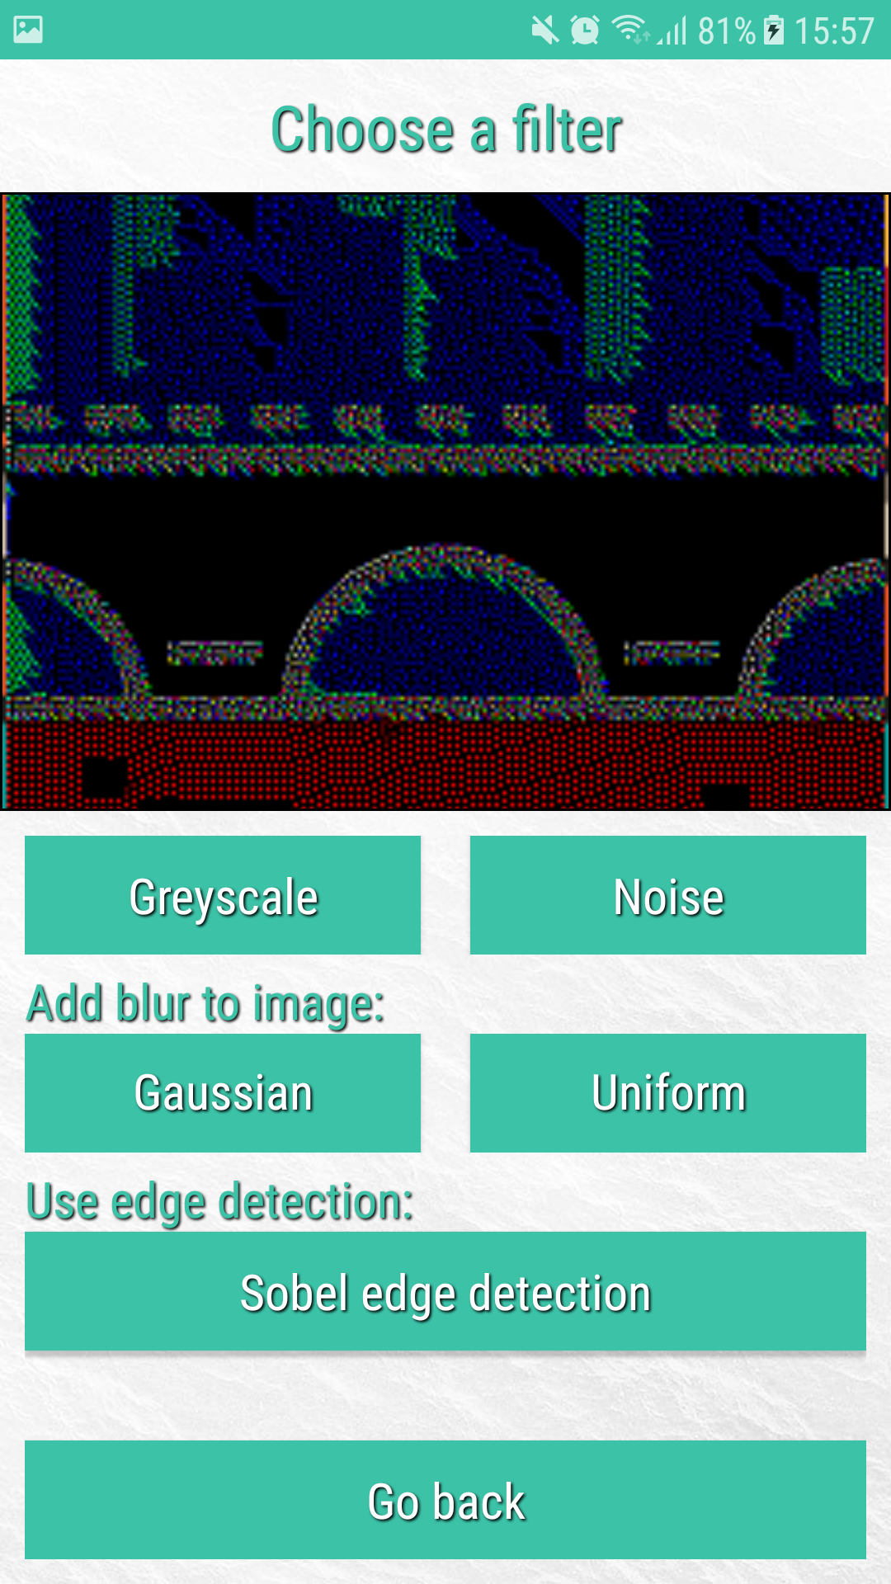
Toolkit features (more)
The effects of some more image processing algorithms developed are illustrated below:
1. Noise
The simulation of a noisy image is produced by an algorithm that iterates through a given images pixel, multiplying a random factor (-1, 0 or 1) by the pixel data. This results in a decrease, increase or no change to the value held in each pixel.
2. Blur
Increased blur is accomplished by generating a Gaussian or Uniform Kernel, which can be represented as a 2D array of specified values. The blur is then accomplished by a convolution between the kernel values and image pixel values.
3. Edge detection
A form of edge detection known as Sobel has been used for this implementation. A Sobel Kernel is generated (represented by a 2D arrays of specified values), which is then convoluted against the pixel values held in the image.

Slide 9
Facial recognition explained
A form of facial recognition known as patch-based correlation has been implemented into the application.
This works by obtaining a patch of the user’s image, which covers a small area of the user’s image.
A patch of the same size and location is then taken from a training image, which is a known persons image stored in a database.
A calculation takes place which generates a correlation score between the two patches.
These scores are accumulated for each image, the highest score represents the image with the most pixel similarities (which may represent a certain facial feature e.g. an eye or moustache)
We can then differentiate between the results to find the name of the closest match, and generate a reconstruction of patches with the highest score.
The reconstruction gives us (the user) a visual representation of how the matched person may have been found.

Slide 10
1. The LFW crop dataset
In-order to calculate patch-based correlation scores a database of known personnel is needed. For this I have used the LFW crop dataset for training images.
The LFW crop dataset is a database of face photographs designed for studying the problem of unconstrained face recognition.
When carrying out facial recognition, the application code loads the database into a usable object
Each person (stored in the database) including their multiple training images are represented by a 4D array. This can be seen below.
Persons [ nth person ][ nth training image ][ pixel_data(x) ][ pixel_data(y) ]

Slide 11
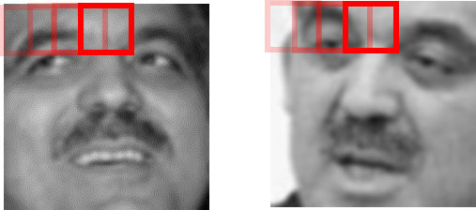
2. Unconstrained recognition
The patches chosen from the users image and the database training image continue to iterate across the entire image accumulating the scores of each patch. The below diagram is a representation of how this works:
The correlation of each patch is calculated using the below formula:
User’s image
Training image

Slide 12
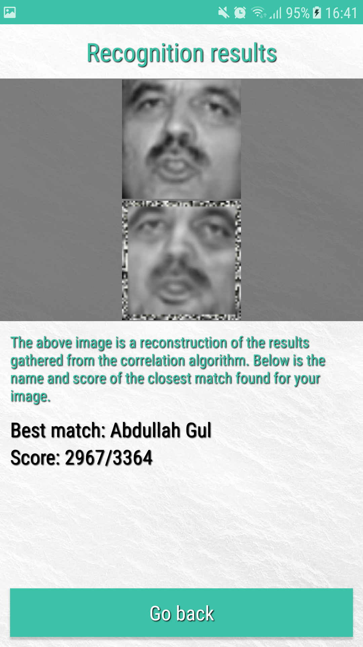
3. Reconstruction of results
The reconstruction image is used to give a visual representation of how accurate the correlation scores are in relation to the person found as the best match.
Throughout correlation algorithm, the best patch scores across all training images are stored in memory.
A new image is then generated, by assigning the pixel data with the patches made up of the best correlation scores.
The correlation scores are affected by parameters such as the size of the patch to be used, or the range of pixels to search. Both of which can be input by the user.

Slide 13
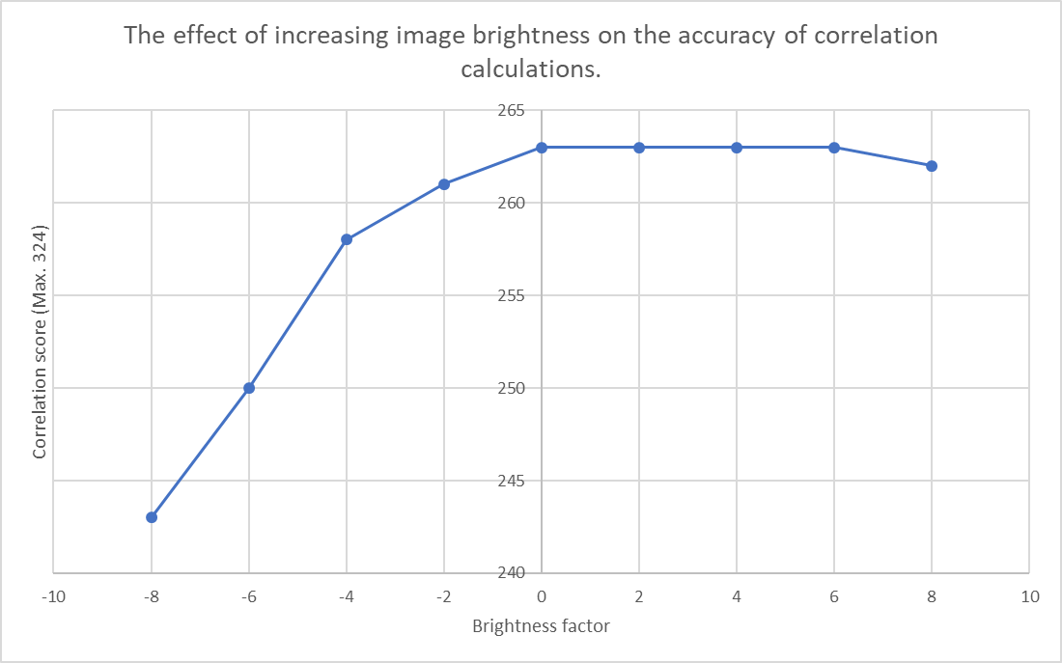
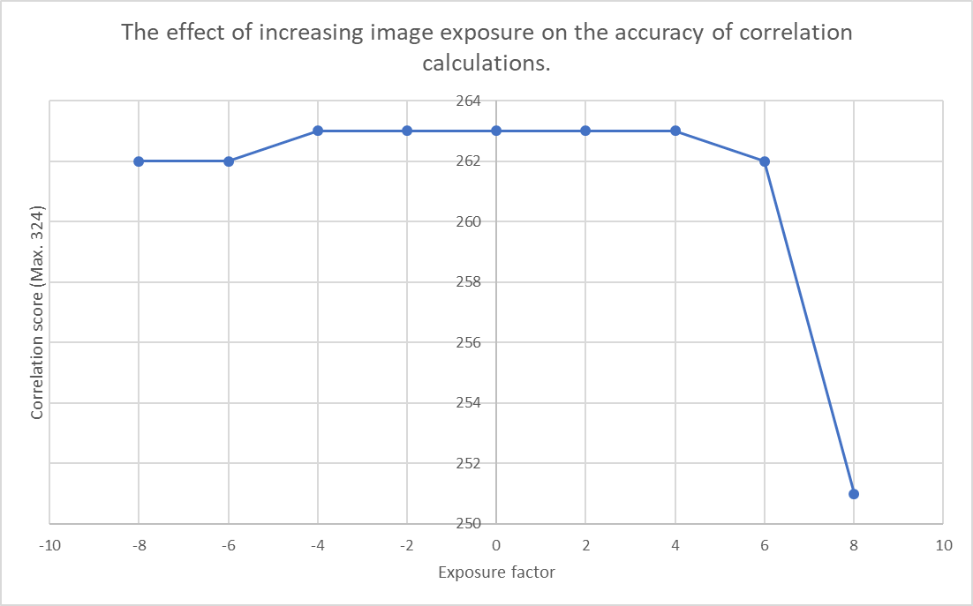
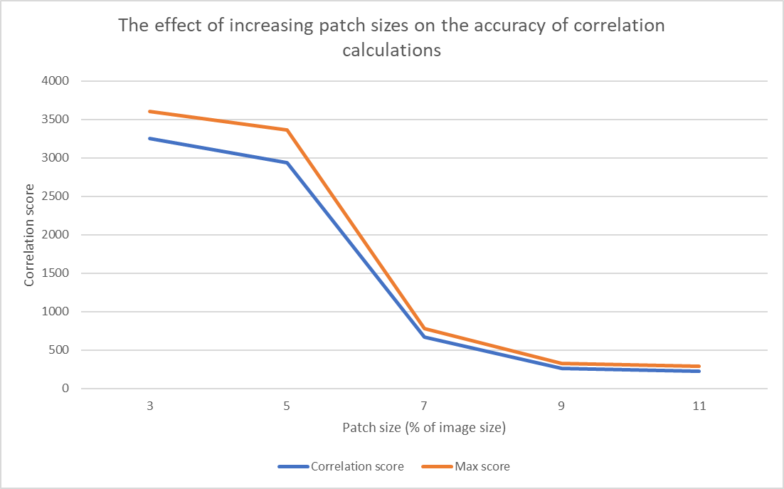
Experiments
The developed image processing and recognition algorithms provided by the application have been used in an experimental approach to analyse the affect of image properties and algorithm inputs (such as patch size) on the accuracy of the patch-based facial recognition.
This should help with better understanding how we may obtain optimal settings to obtain better results.
A few of the carried out experiments are illustrated below:

Slide 14
Testing
To test the final application, I have made use of unit testing functionality available in Android studio. The unit tests I have written cover all image processing algorithms ensure the expected change to the user’s image is obtained.
The unit tests also test the validity of results obtained from the facial recognition feature, ensuring the correct match is found for a given test case.
Testing the navigation through the application has been automated, using various test cases to account for memory leaks caused by the incorrect use of image transfer between screens.
Manual testing has also been carried out to test user input validation, required when inputting patch-size and range before facial recognition.

